Slide 1
CSE 185 Introduction to Computer Vision
Image Filtering:
Templates, Image Pyramids, and Filter Banks

Slide 2
Image filtering
Template matching
Image Pyramids
Filter banks and texture

Slide 3
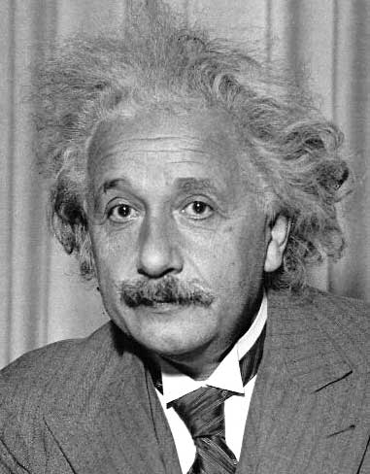
Template matching
Goal: find in image
Main challenge: What is a good similarity or distance measure between two patches?
Correlation
Zero-mean correlation
Sum Square Difference
Normalized Cross Correlation

Slide 4
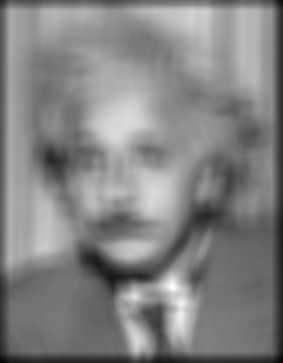
Matching with filters
Goal: find in image
Method 0: filter the image with eye patch
f = image
g = filter
What went wrong?
Problem: response is stronger for higher intensity
Input
Filtered Image
Notes:
Problem: response is stronger for higher intensity

Slide 5
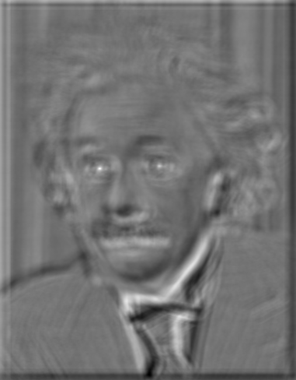

Matching with filters
Goal: find in image
Method 1: filter the image with zero-mean eye
True detections
Problem: response is sensitive to gain/contrast: pixels in filter that are near the mean have little effect (does not require pixel values in image to be near or proportional to values in filter)
False detections
Input
Filtered Image (scaled)
Thresholded Image
Notes:
Likes bright pixels where filters are above average, dark pixels where filters are below average. Problems: response is sensitive to gain/contrast, pixels in filter that are near the mean have little effect, does not require pixel values in image to be near or proportional to values in filter.

Slide 6
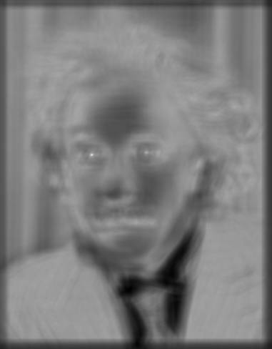

Matching with filters
Goal: find in image
Method 2: SSD
True detections
Problem: SSD sensitive to average intensity
Input
sqrt(SSD)
Thresholded Image
Notes:
Problem: SSD sensitive to average intensity

Slide 7
Matching with filters
Can SSD be implemented with linear filters?

Slide 8
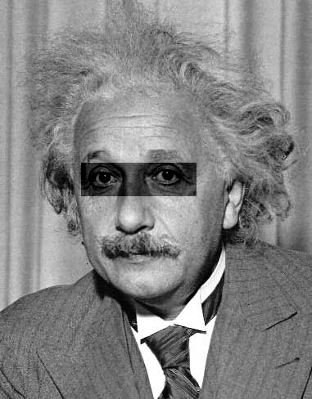
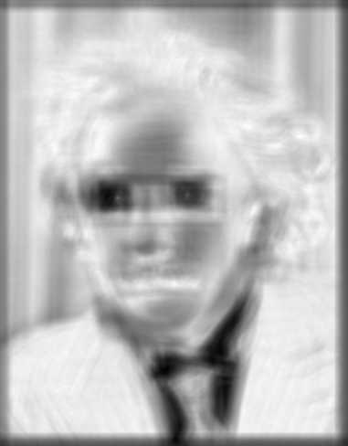
Matching with filters
Goal: find in image
Method 2: SSD
What’s the potential downside of SSD?
SSD sensitive to average intensity
Input
1- sqrt(SSD)
Notes:
Problem: SSD sensitive to average intensity

Slide 9
Matching with filters
Goal: find in image
Method 3: Normalized cross-correlation
Invariant to mean and scale of intensity
mean template
mean image patch
Dot product of two normalized vectors
Matlab: normxcorr2(template, im)
Notes:
Invariant to mean and scale of intensity

Slide 10
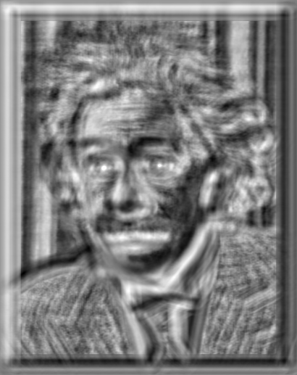

Matching with filters
Goal: find in image
Method 3: Normalized cross-correlation
True detections
Input
Normalized X-Correlation
Thresholded Image

Slide 11
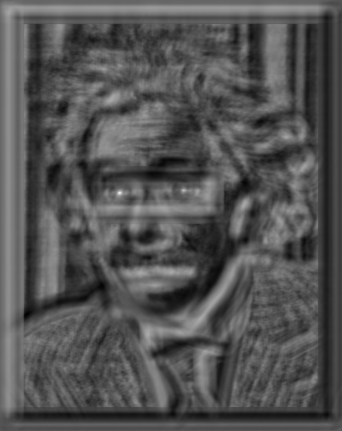
Matching with filters
Goal: find in image
Method 3: Normalized cross-correlation
True detections
Input
Normalized X-Correlation
Thresholded Image

Slide 12
What is the best method to use?
A: Depends
SSD: faster, sensitive to overall intensity
Normalized cross-correlation: slower, invariant to local average intensity and contrast
But really, neither of these baselines are representative of modern recognition

Slide 13
How to find larger or smaller eyes?
A: Image Pyramid

Slide 14
Review of sampling
Gaussian
Filter
Image
Low-Pass Filtered Image
Sample
Low-Res Image

Slide 15
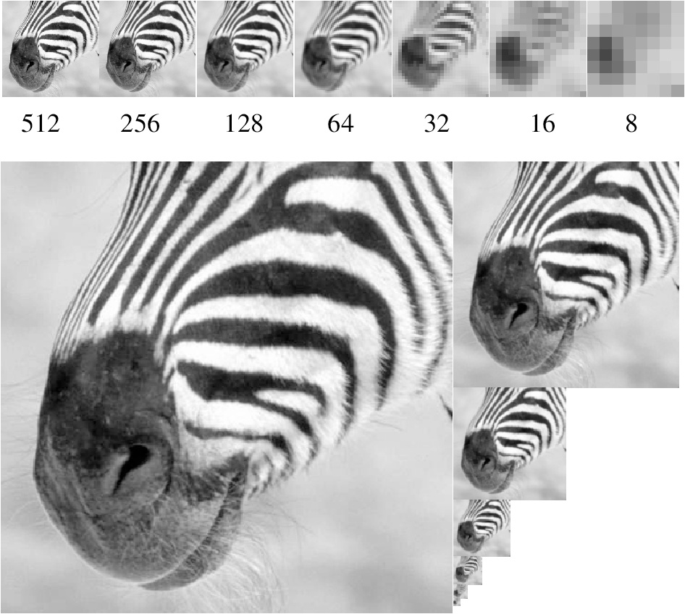
Gaussian pyramid
Source: Forsyth

Slide 16
Template matching with image pyramids
Input: Image, Template
Match template at current scale
Downsample image
Repeat 1-2 until image is very small
Take responses above some threshold, perhaps with non-maxima suppression

Slide 17
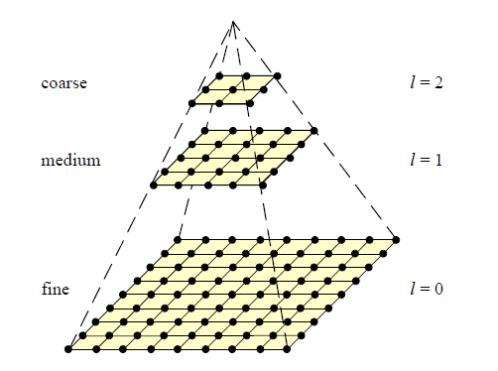
Coarse-to-fine image registration
Compute Gaussian pyramid
Align with coarse pyramid
Successively align with finer pyramids
Search smaller range
Why is this faster?
Are we guaranteed to get the same result?

Slide 18
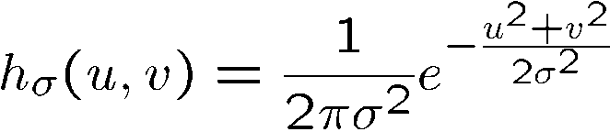
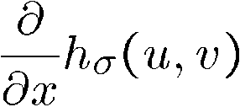
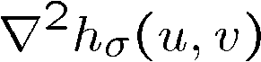
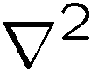
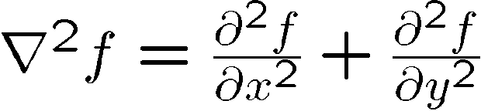
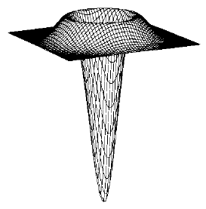
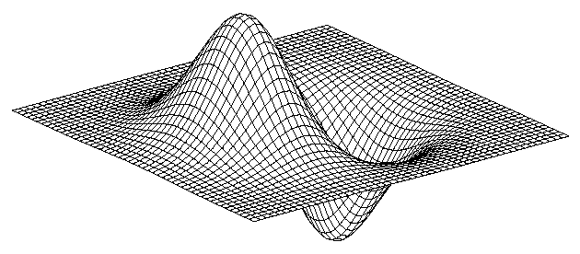
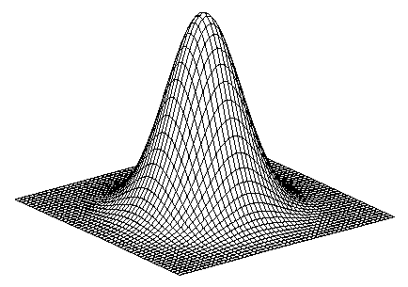
2D edge detection filters
Laplacian of Gaussian
Gaussian
derivative of Gaussian
is the Laplacian operator:
Notes:
How many 2nd derivative filters are there? There are four 2nd partial derivative filters.
In practice, it’s handy to define a single 2nd derivative filter—the Laplacian

Slide 19
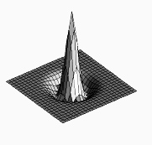

Laplacian filter
unit impulse
Gaussian
Laplacian of Gaussian

Slide 20
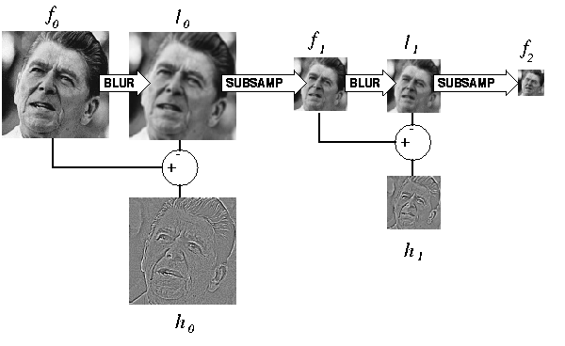
Gaussian/Laplacian pyramid
Can we reconstruct the original from the Laplacian pyramid?

Slide 21
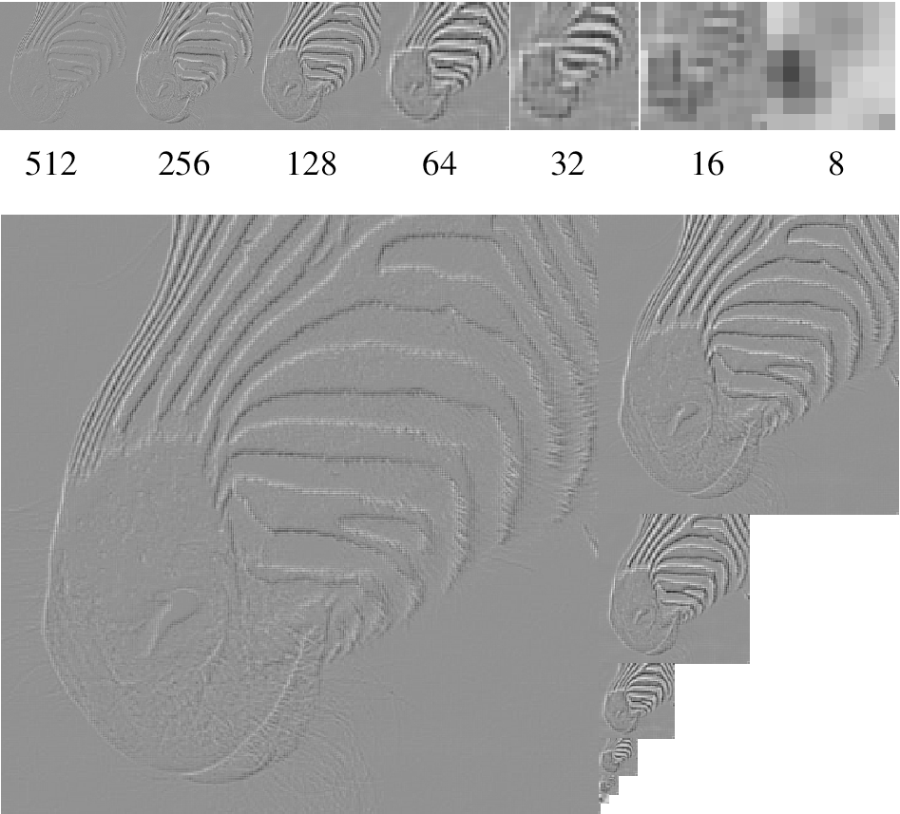
Laplacian pyramid

Slide 22
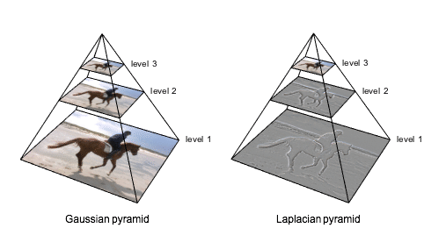
Visual representation

Slide 23
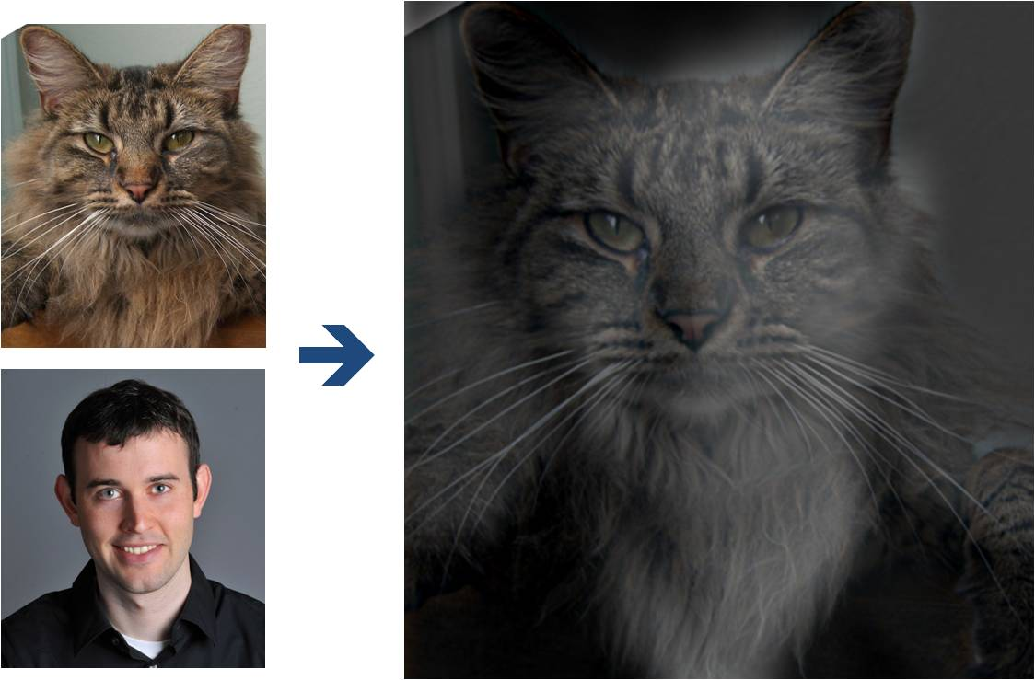
Perception
Why do we get different, distance-dependent interpretations of hybrid images?
?

Slide 24
Hybrid Image

Slide 25
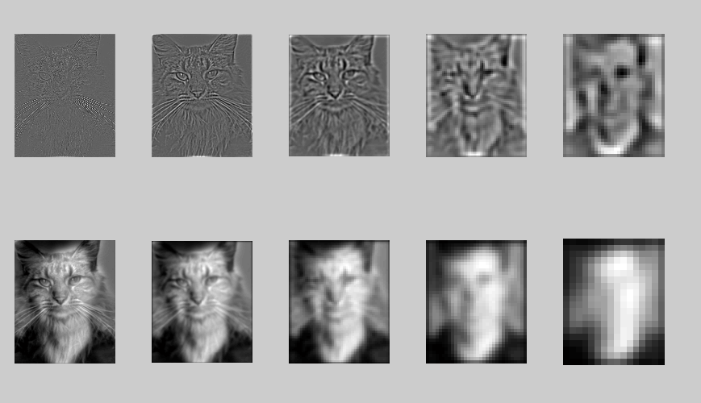
Hybrid Image in Laplacian pyramid
High frequency → Low frequency

Slide 26
Image representation
Pixels: great for spatial resolution, poor access to frequency
Fourier transform: great for frequency, not for spatial info
Pyramids/filter banks: balance between spatial and frequency information

Slide 27
Main uses of image pyramids
Compression
Object detection
Scale search
Features
Detecting stable interest points
Registration
Course-to-fine

Slide 28
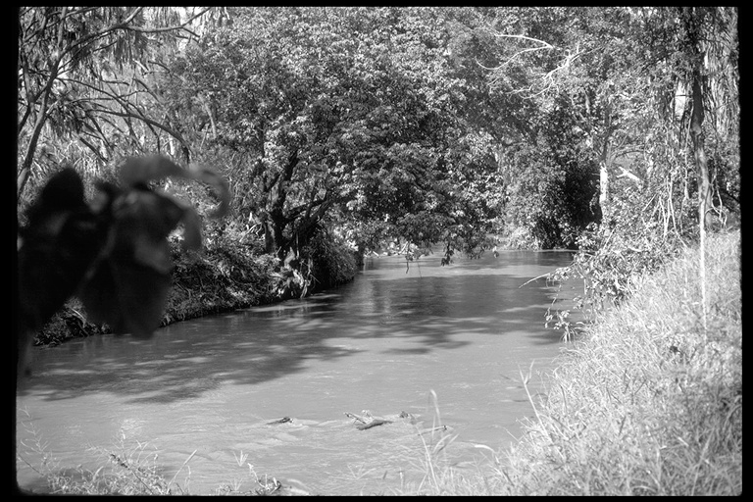
Application: Representing texture
Source: Forsyth

Slide 29
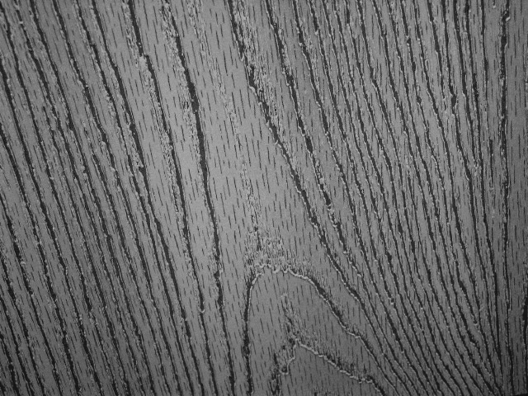
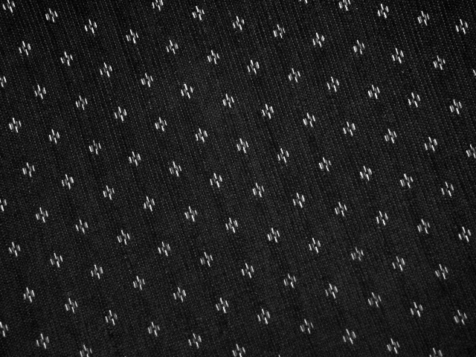
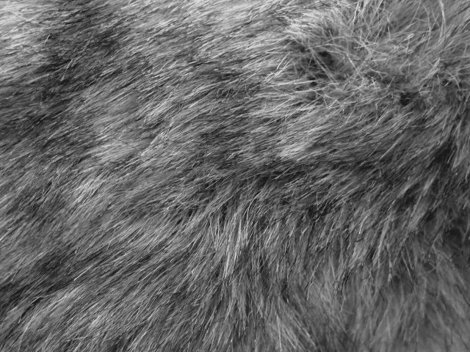
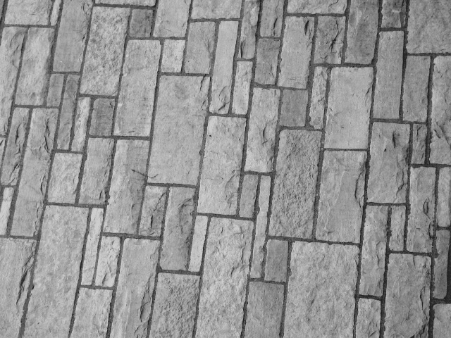
Texture and material

Slide 32
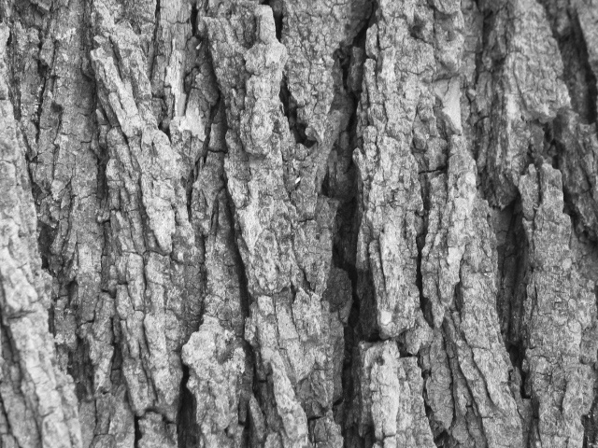
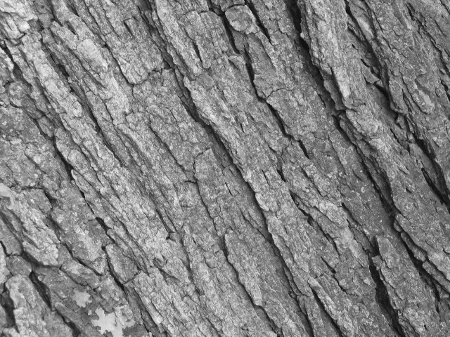
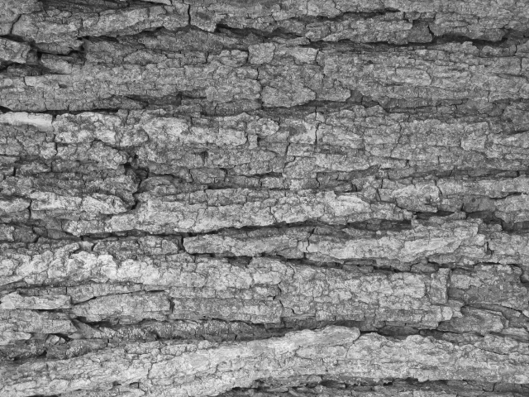
Texture and orientation

Slide 35
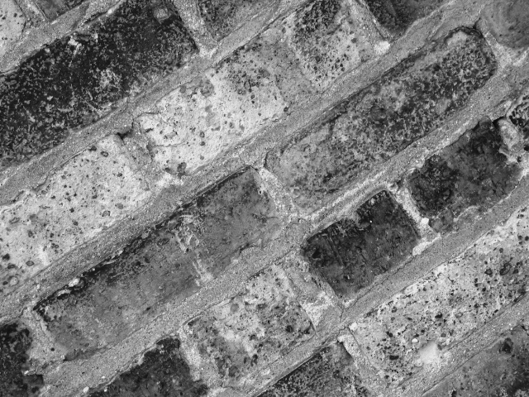
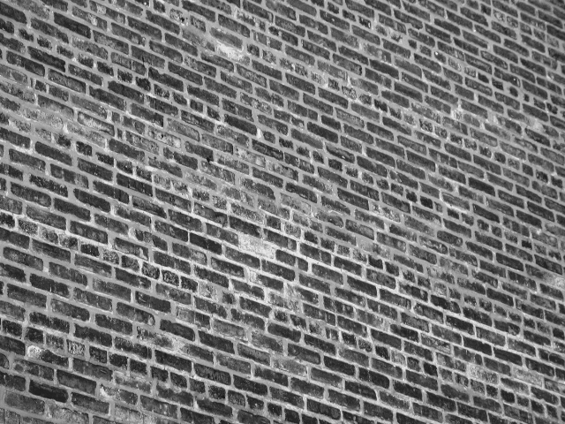
Texture and scale

Slide 36
What is texture?
Regular or stochastic patterns caused by bumps, grooves, and/or markings

Slide 37
How can we represent texture?
Compute responses of blobs and edges at various orientations and scales

Slide 38
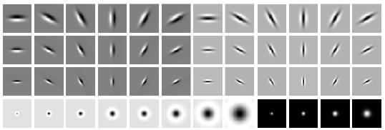
Overcomplete representation
Leung-Malik Filter Bank
First and second order derivatives fo Gaussians at 6 orientations and 3 scales
8 Laplacian of Gaussian and 4 Gaussian filters
Code for filter banks: www.robots.ox.ac.uk/~vgg/research/texclass/filters.html

Slide 39
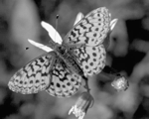
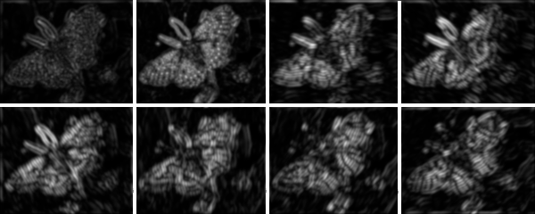
Filter banks
Process image with each filter and keep responses (or squared/abs responses)

Slide 40
How can we represent texture?
Measure responses of blobs and edges at various orientations and scales
Idea 1: Record simple statistics (e.g., mean, standard deviation) of absolute filter responses

Slide 41
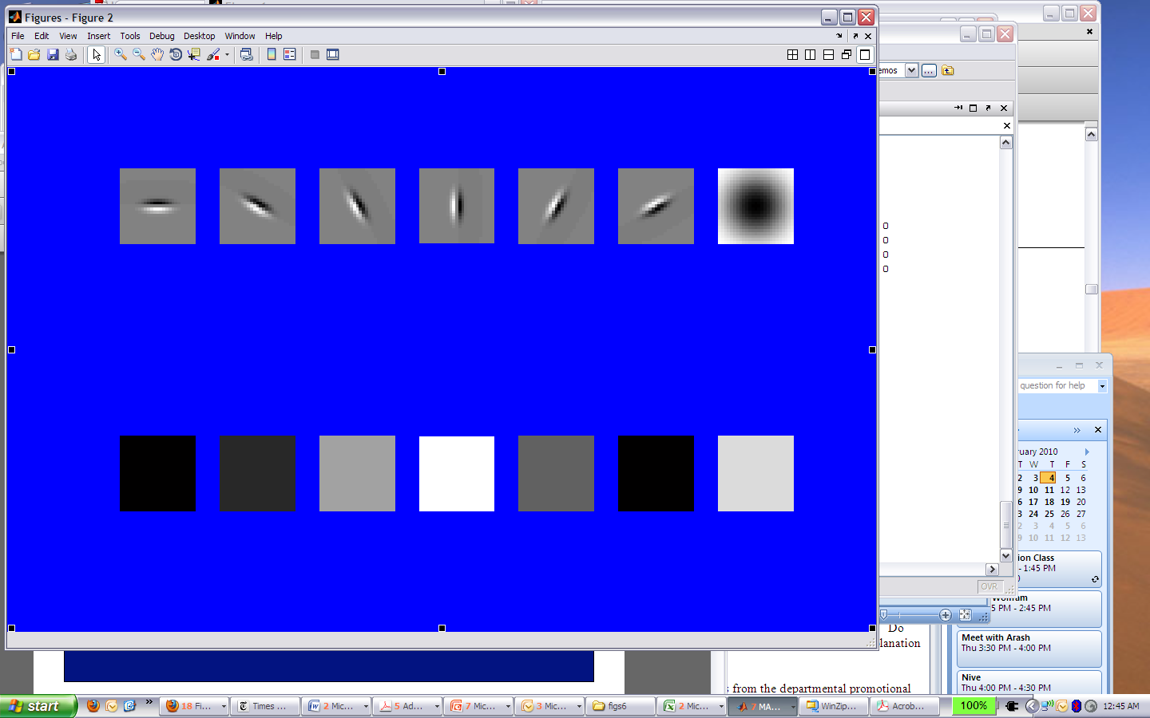
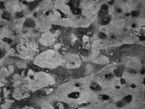
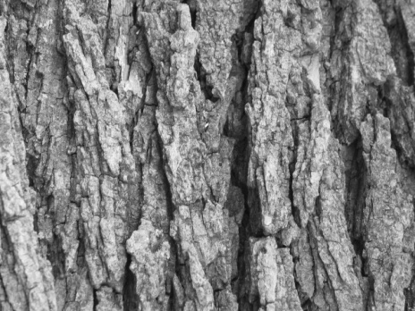
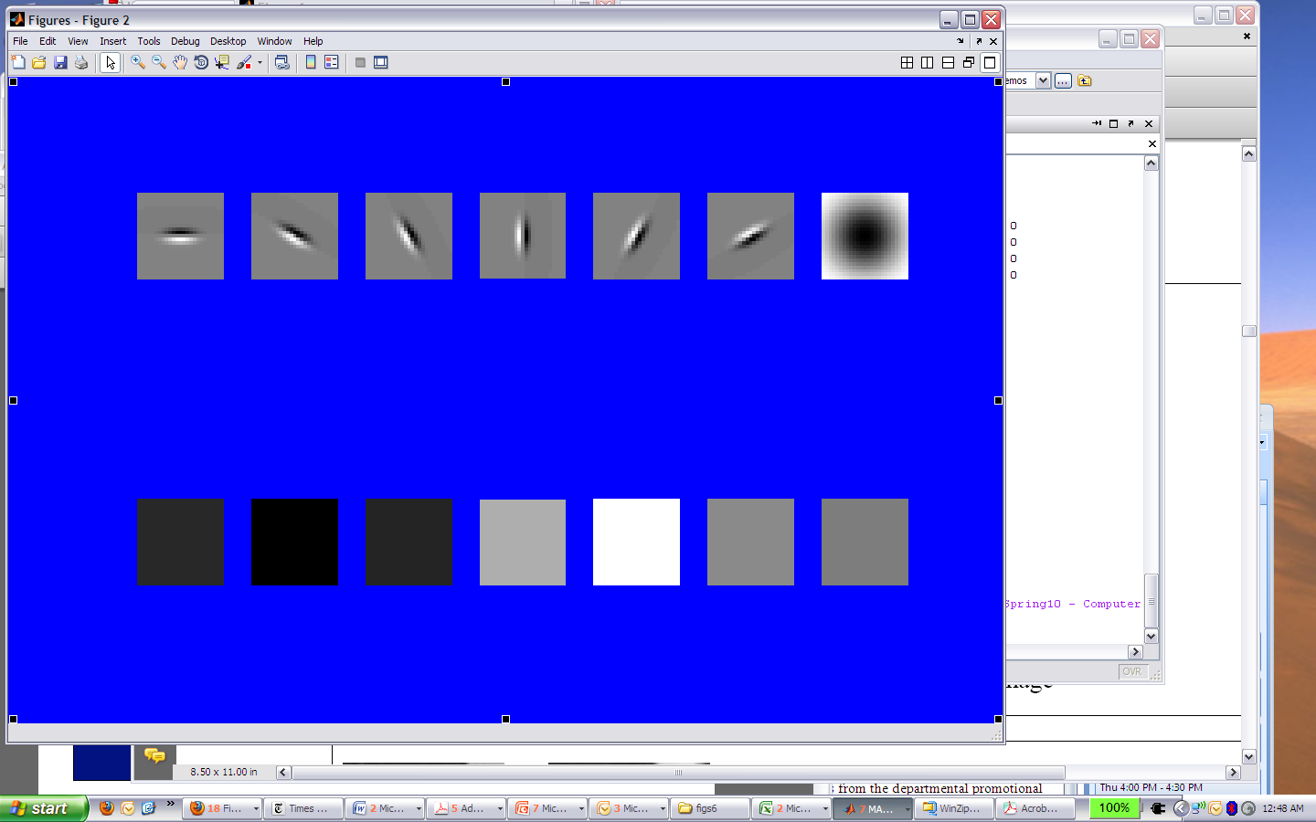
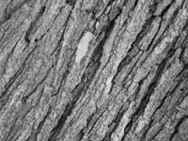
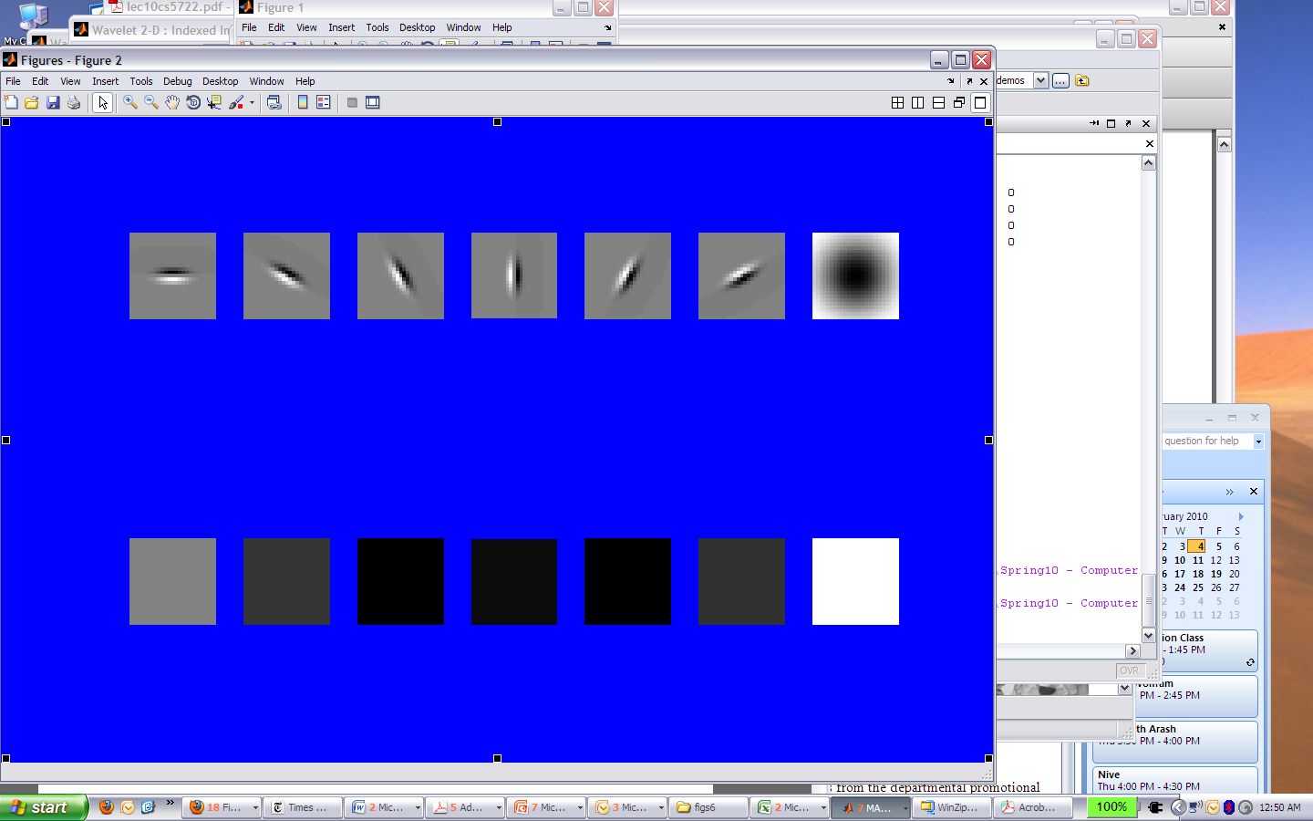
Match the texture to the response?
Filters
A
1
B
2
C
3
Mean abs responses

Slide 42

Representing texture by mean abs response
Filters
Mean abs responses

Slide 43
Representing texture
Idea 2: take vectors of filter responses at each pixel and cluster them, then take histograms (more on in later weeks)

Slide 44
Compression
How is it that a 4MP image can be compressed to a few hundred KB without a noticeable change?

Slide 45
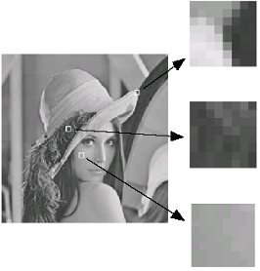
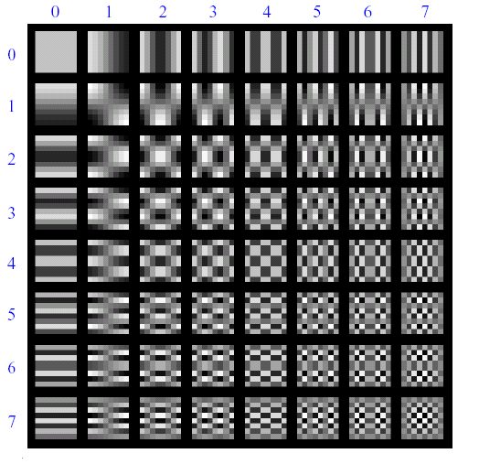
Lossy image compression (JPEG)
64 basis functions
DFT: complex values
DCT: real values
Block-based Discrete Cosine Transform (DCT)
See https://www.mathworks.com/help/images/discrete-cosine-transform.html
Slides: Efros

Slide 46
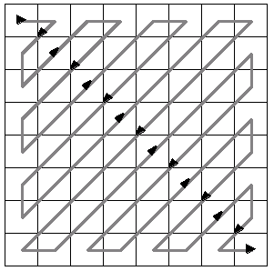
Using DCT in JPEG
The first coefficient B(0,0) is the DC component, the average intensity
The top-left coeffs represent low frequencies, the bottom right – high frequencies

Slide 47
Image compression using DCT
Quantize
More coarsely for high frequencies (which also tend to have smaller values)
Many quantized high frequency values will be zero
Encode
Can decode with inverse dct
Filter responses
Quantization table
Quantized values

Slide 48
JPEG compression summary
Convert image to YCrCb
Subsample color by factor of 2
People have bad resolution for color
Split into blocks (8x8, typically), subtract 128
For each block
Compute DCT coefficients
Coarsely quantize
Many high frequency components will become zero
Encode (e.g., with Huffman coding)
http://en.wikipedia.org/wiki/YCbCr
http://en.wikipedia.org/wiki/JPEG

Slide 49
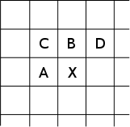
Lossless compression (PNG)
Predict that a pixel’s value based on its upper-left neighborhood
Store difference of predicted and actual value
Pkzip it (DEFLATE algorithm)

Slide 50

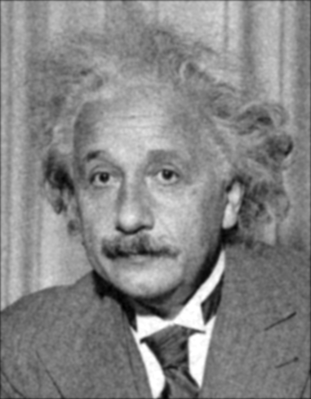
Denoising
Gaussian Filter
Additive Gaussian Noise

Slide 51
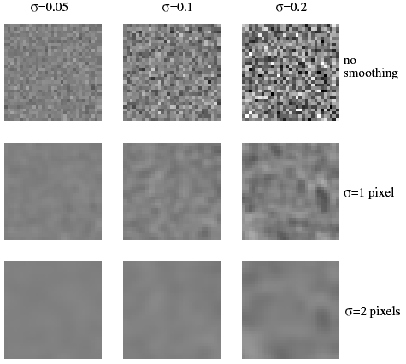
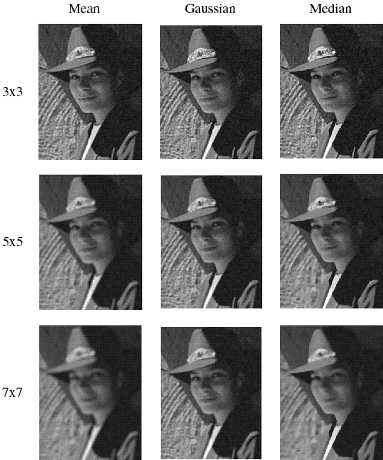
Reducing Gaussian noise
Smoothing with larger standard deviations suppresses noise, but also blurs the image

Slide 52

Reducing salt-and-pepper noise by Gaussian smoothing
3x3
5x5
7x7
Notes:
What’s wrong with these results?

Slide 53

Alternative idea: Median filtering
A median filter operates over a window by selecting the median intensity in the window
Is median filtering linear?
Notes:
Better at salt’n’pepper noise
Not convolution: try a region with 1’s and a 2, and then 1’s and a 3

Slide 54

Median filter
What advantage does median filtering have over Gaussian filtering?
Robustness to outliers

Slide 55

Median filter
Salt-and-pepper noise
Median filtered
MATLAB: medfilt2(image, [h w])

Slide 56

Median vs. Gaussian filtering
3x3
5x5
7x7
Gaussian
Median

Slide 57

Other non-linear filters
Weighted median (pixels further from center count less)
Clipped mean (average, ignoring few brightest and darkest pixels)
Bilateral filtering (weight by spatial distance and intensity difference)
Bilateral filtering

Slide 58

Review: Image filtering
1
1
1
1
1
1
1
1
1
0 | 0 | 0 | 0 | 0 | 0 | 0 | 0 | 0 | 0
0 | 0 | 0 | 0 | 0 | 0 | 0 | 0 | 0 | 0
0 | 0 | 0 | 90 | 90 | 90 | 90 | 90 | 0 | 0
0 | 0 | 0 | 90 | 90 | 90 | 90 | 90 | 0 | 0
0 | 0 | 0 | 90 | 90 | 90 | 90 | 90 | 0 | 0
0 | 0 | 0 | 90 | 0 | 90 | 90 | 90 | 0 | 0
0 | 0 | 0 | 90 | 90 | 90 | 90 | 90 | 0 | 0
0 | 0 | 0 | 0 | 0 | 0 | 0 | 0 | 0 | 0
0 | 0 | 90 | 0 | 0 | 0 | 0 | 0 | 0 | 0
0 | 0 | 0 | 0 | 0 | 0 | 0 | 0 | 0 | 0
 | 0
0 | 0 | 0 | 0 | 0 | 0 | 0 | 0 | 0 | 0
0 | 0 | 0 | 0 | 0 | 0 | 0 | 0 | 0 | 0
0 | 0 | 0 | 90 | 90 | 90 | 90 | 90 | 0 | 0
0 | 0 | 0 | 90 | 90 | 90 | 90 | 90 | 0 | 0
0 | 0 | 0 | 90 | 90 | 90 | 90 | 90 | 0 | 0
0 | 0 | 0 | 90 | 0 | 90 | 90 | 90 | 0 | 0
0 | 0 | 0 | 90 | 90 | 90 | 90 | 90 | 0 | 0
0 | 0 | 0 | 0 | 0 | 0 | 0 | 0 | 0 | 0
0 | 0 | 90 | 0 | 0 | 0 | 0 | 0 | 0 | 0
0 | 0 | 0 | 0 | 0 | 0 | 0 | 0 | 0 | 0
Credit: S. Seitz
Notes:
ones, divide by 9

Slide 59
Image filtering
1
1
1
1
1
1
1
1
1
0 | 0 | 0 | 0 | 0 | 0 | 0 | 0 | 0 | 0
0 | 0 | 0 | 0 | 0 | 0 | 0 | 0 | 0 | 0
0 | 0 | 0 | 90 | 90 | 90 | 90 | 90 | 0 | 0
0 | 0 | 0 | 90 | 90 | 90 | 90 | 90 | 0 | 0
0 | 0 | 0 | 90 | 90 | 90 | 90 | 90 | 0 | 0
0 | 0 | 0 | 90 | 0 | 90 | 90 | 90 | 0 | 0
0 | 0 | 0 | 90 | 90 | 90 | 90 | 90 | 0 | 0
0 | 0 | 0 | 0 | 0 | 0 | 0 | 0 | 0 | 0
0 | 0 | 90 | 0 | 0 | 0 | 0 | 0 | 0 | 0
0 | 0 | 0 | 0 | 0 | 0 | 0 | 0 | 0 | 0
 | 0 | 10
0 | 0 | 0 | 0 | 0 | 0 | 0 | 0 | 0 | 0
0 | 0 | 0 | 0 | 0 | 0 | 0 | 0 | 0 | 0
0 | 0 | 0 | 90 | 90 | 90 | 90 | 90 | 0 | 0
0 | 0 | 0 | 90 | 90 | 90 | 90 | 90 | 0 | 0
0 | 0 | 0 | 90 | 90 | 90 | 90 | 90 | 0 | 0
0 | 0 | 0 | 90 | 0 | 90 | 90 | 90 | 0 | 0
0 | 0 | 0 | 90 | 90 | 90 | 90 | 90 | 0 | 0
0 | 0 | 0 | 0 | 0 | 0 | 0 | 0 | 0 | 0
0 | 0 | 90 | 0 | 0 | 0 | 0 | 0 | 0 | 0
0 | 0 | 0 | 0 | 0 | 0 | 0 | 0 | 0 | 0
Credit: S. Seitz
Notes:
ones, divide by 9

Slide 60
Image filtering
1
1
1
1
1
1
1
1
1
0 | 0 | 0 | 0 | 0 | 0 | 0 | 0 | 0 | 0
0 | 0 | 0 | 0 | 0 | 0 | 0 | 0 | 0 | 0
0 | 0 | 0 | 90 | 90 | 90 | 90 | 90 | 0 | 0
0 | 0 | 0 | 90 | 90 | 90 | 90 | 90 | 0 | 0
0 | 0 | 0 | 90 | 90 | 90 | 90 | 90 | 0 | 0
0 | 0 | 0 | 90 | 0 | 90 | 90 | 90 | 0 | 0
0 | 0 | 0 | 90 | 90 | 90 | 90 | 90 | 0 | 0
0 | 0 | 0 | 0 | 0 | 0 | 0 | 0 | 0 | 0
0 | 0 | 90 | 0 | 0 | 0 | 0 | 0 | 0 | 0
0 | 0 | 0 | 0 | 0 | 0 | 0 | 0 | 0 | 0
 | 0 | 10 | 20
0 | 0 | 0 | 0 | 0 | 0 | 0 | 0 | 0 | 0
0 | 0 | 0 | 0 | 0 | 0 | 0 | 0 | 0 | 0
0 | 0 | 0 | 90 | 90 | 90 | 90 | 90 | 0 | 0
0 | 0 | 0 | 90 | 90 | 90 | 90 | 90 | 0 | 0
0 | 0 | 0 | 90 | 90 | 90 | 90 | 90 | 0 | 0
0 | 0 | 0 | 90 | 0 | 90 | 90 | 90 | 0 | 0
0 | 0 | 0 | 90 | 90 | 90 | 90 | 90 | 0 | 0
0 | 0 | 0 | 0 | 0 | 0 | 0 | 0 | 0 | 0
0 | 0 | 90 | 0 | 0 | 0 | 0 | 0 | 0 | 0
0 | 0 | 0 | 0 | 0 | 0 | 0 | 0 | 0 | 0
Credit: S. Seitz
Notes:
ones, divide by 9

Slide 61


Filtering in spatial domain
1
0
-1
2
0
-2
1
0
-1
*
=

Slide 62


Filtering in frequency domain
FFT
FFT
=
Inverse FFT

Slide 63
Review of image filtering
Filtering in spatial domain
Slide filter over image and take dot product at each position
Remember linearity (for linear filters)
Examples
1D: [-1 0 1], [0 0 0 0 0.5 1 1 1 0.5 0 0 0]
1D: [0.25 0.5 0.25], [0 0 0 0 0.5 1 1 1 0.5 0 0 0]
2D: [1 0 0 ; 0 2 0 ; 0 0 1]/4

Slide 64
Review of image filtering
Filtering in frequency domain
Can be faster than filtering in spatial domain (for large filters)
Can help understand effect of filter
Algorithm:
Convert image and filter to fft (fft2 in matlab)
Pointwise-multiply ffts
Convert result to spatial domain with ifft2

Slide 65


Review of image filtering
Linear filters for basic processing
Edge filter (high-pass)
Gaussian filter (low-pass)
[-1 1]
Gaussian
FFT of Gradient Filter
FFT of Gaussian

Slide 66

Review of image filtering
Derivative of Gaussian

Slide 67
Review of image filtering
Applications of filters
Template matching (SSD or Normxcorr2)
SSD can be done with linear filters, is sensitive to overall intensity
Gaussian pyramid
Coarse-to-fine search, multi-scale detection
Laplacian pyramid
Teases apart different frequency bands while keeping spatial information
Can be used for compositing in graphics
Downsampling
Need to sufficiently low-pass before downsampling

